Slide 1
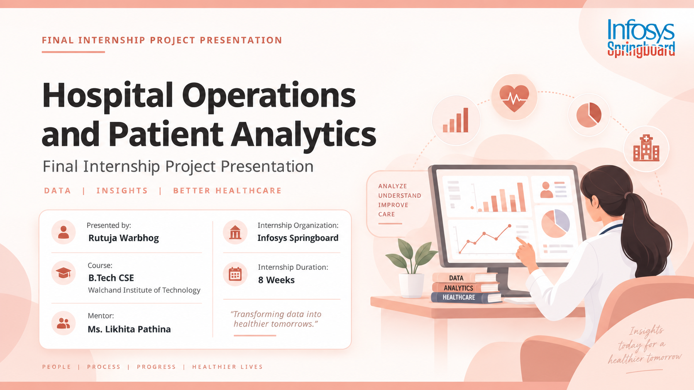
Notes:
Good morning. I am Rutuja Warbhog, final-year B.Tech CSE student at Walchand Institute of Technology. This is my final internship project presentation on Hospital Operations and Patient Analytics, completed under Infosys Springboard with mentor Ms. Likhita Pathina.

Slide 2

Internship Objectives
1
Learn the complete analytics workflow
Move from raw CSV data to cleaned datasets, KPIs, dashboards and documentation.
2
Strengthen Python and Pandas skills
Use Pandas and NumPy for cleaning, derived fields and independent KPI validation.
3
Build business intelligence capability
Design interactive dashboards in Tableau and Power BI with filters and navigation.
4
Think in metrics, not records
Define KPIs precisely — formula, denominator and data grain — before visualising them.
5
Practice testing and communication
Run structured QA on dashboards and present findings clearly to reviewers.
04
Notes:
These were the objectives I set at the start: workflow, Python, BI tools, metric discipline and communication.

Slide 3
Project Introduction
Hospital Operations & Patient Analysis
A healthcare analytics and visualisation project that converts hospital operational and patient-level data into clear management insights.
The analysis covers admissions and discharges, patient transfers, department performance, billing and revenue, readmissions, bed and ICU capacity, staffing and equipment utilisation — presented as one connected analytical view.
Goal: support descriptive operational analysis and decision support — not clinical diagnosis or treatment decisions.
06
Notes:
The dataset covers ten thousand admission records across fifty-three fields, delivered as four connected dashboards.

Slide 4
Problem Statement
The situation
No single operational view
1
Separate tables for patients, capacity, staff and revenue.
Hospital datasets hold a very large number of operational records and measures. Admissions, patient movement, revenue, capacity, staffing and equipment information are usually stored and reviewed separately.
Reviewed in isolation, none of these tables explains the overall operational picture — and manual review makes comparison across departments and periods slow and error-prone.
2
Hard to compare
Departments, hospitals and time periods cannot be lined up quickly.
3
Trends stay hidden
Length of stay, readmission and utilisation patterns are not visible.
4
KPIs are unverified
No consistent definition, denominator or independent check.
07
Notes:
The core problem is fragmentation: the data exists, but not in a form that answers operational questions.

Slide 5
Project Objectives & Scope
2
1
2
3
4
5
Patient Flow
Department Performance
Financial Metrics
Resources & Capacity
Dashboard Delivery
Admission and discharge trends
Transfers between departments
Age groups and stay categories
Workload and patient volume
Staffing and bed capacity
Department-wise readmission
Billing amount and revenue
Insurance provider mix
Revenue against length of stay
Bed and ICU occupancy
Staff utilisation rates
Equipment status and usage
Four connected dashboards
Consistent filters and navigation
Validated KPI definitions
09
Notes:
Scope was fixed across five areas so each dashboard answers a distinct operational question.

Slide 6
SECTION 04
Tools & Technologies
Py
pd
np
Jn
Python
Pandas
NumPy
Jupyter Notebook
Data preparation, cleaning and transformation
Grouping, calculations and KPI validation
Numerical operations during analysis
Cleaning and validation workflow
Tb
BI
xls
Git
Tableau Desktop
Power BI
CSV / Excel
GitHub
Main dashboard development platform
Second visualisation build of the solution
Raw, cleaned and analytical datasets
Version control, storage and delivery
Python and Pandas were used as an independent check on every headline KPI shown in the dashboards.
05
Notes:
Tableau was the primary dashboard tool; Power BI was used to rebuild the same solution. Python and Pandas validated every headline KPI.

Slide 7
Project Methodology
1
Data Collection
2
Data Cleaning
3
Derived Fields
Collect raw hospital dataset in CSV format.
→
Check structure, missing values, duplicates and dates.
→
Create age group, admission month/year and LOS category.
4
KPI Engineering
5
Dashboard Build
6
Testing & Delivery
Calculate hospital, patient-flow and resource KPIs.
→
Develop four connected dashboards with filters.
→
Validate KPIs in Pandas and prepare final documents.
Raw Dataset → Cleaning → Transformation → KPI Creation → Dashboard Development → Testing → Documentation
Notes:
The methodology follows an end-to-end data analytics workflow from raw data to validated dashboards and documentation.

Slide 8
Dataset Description
What the 53 fields cover
10,000
Records
Data area | Important fields
Hospital | Hospital ID, Hospital Name, Hospital Type, City, State
Patient | Patient ID, Patient Name, Gender, Age, Blood Type
Admissions | Admission Date, Discharge Date, Admission Type
Clinical / Service | Diagnosis, Treatment, Medication, Test Result
Financial | Billing Amount, Insurance Provider
Resources | Beds, ICU Beds, Doctors, Nurses, Staff Count
Equipment | Equipment ID, Equipment Status, Usage Duration
Transfers | Transferred, Transfer From/To Department, Transfer Date
53
Fields
10
Departments
4
Data grains kept separate
Patient · Department · Hospital · Equipment
10
Notes:
The working dataset is 10,000 records and 53 fields spanning eight data areas. Four different data grains sit inside one file, which is why aggregation had to be handled carefully.

Slide 9
Data Cleaning & Preparation
Cleaning steps performed
Length of Stay after cleaning
1
1
Structure check
Mean
78.78 days
Field names, dataset structure, data types and overall completeness verified.
2
Missing & duplicates
Median
44 days
Missing values, duplicate records and key identifiers reviewed.
3
Standardisation
Maximum
338 days
Categorical values such as departments and operational indicators normalised.
4
Date validation
Records over 30 days
5,497
Admission and discharge dates checked; same-day stays retained as 0 days.
5
Length of Stay rebuilt
Records over 90 days
3,706
LOS recalculated as Discharge Date minus Admission Date, not taken as given.
The gap between the mean (78.78) and the median (44) shows a long right tail — a small group of very long stays pulls the average up, so both measures are reported together.
11
Notes:
Cleaning was not just removing nulls — the key decisions were retaining same-day stays as zero days, recalculating length of stay from the dates, and keeping the four data grains separate.

Slide 10
Derived Fields & KPI Engineering
Fields created during preparation
KPIs validated in Pandas
Age Group
Admission Month
Admission Year
KPI | Validated value
Total admissions | 10,000
Total revenue | Rs. 2.50 Billion
Average length of stay | 78.78 days
Average patient age | 45.30 years
Readmission rate | 49.87%
Bed utilisation | 36.76%
Staff utilisation | 57.92%
Equipment utilisation | 33.55%
Patients transferred | 1,760 (17.60%)
Avg. daily admissions | 19.05
LOS Category
Dept Bed Capacity
ICU Capacity
Staff Utilisation %
Bed Occupancy Rate %
Efficiency Score = (Bed Utilisation x 0.40) + (Staff Utilisation x 0.40) + ((1 - Readmission Rate) x 0.20) = 47.90%
12
Notes:
Bed occupancy is the KPI to be careful with: averaging the prepared Bed_Occupancy_Rate_% field gives 36.76%, while a count of Bed Occupied = Yes gives a different answer. The definition and denominator have to stay consistent wherever the metric is reported.

Slide 11
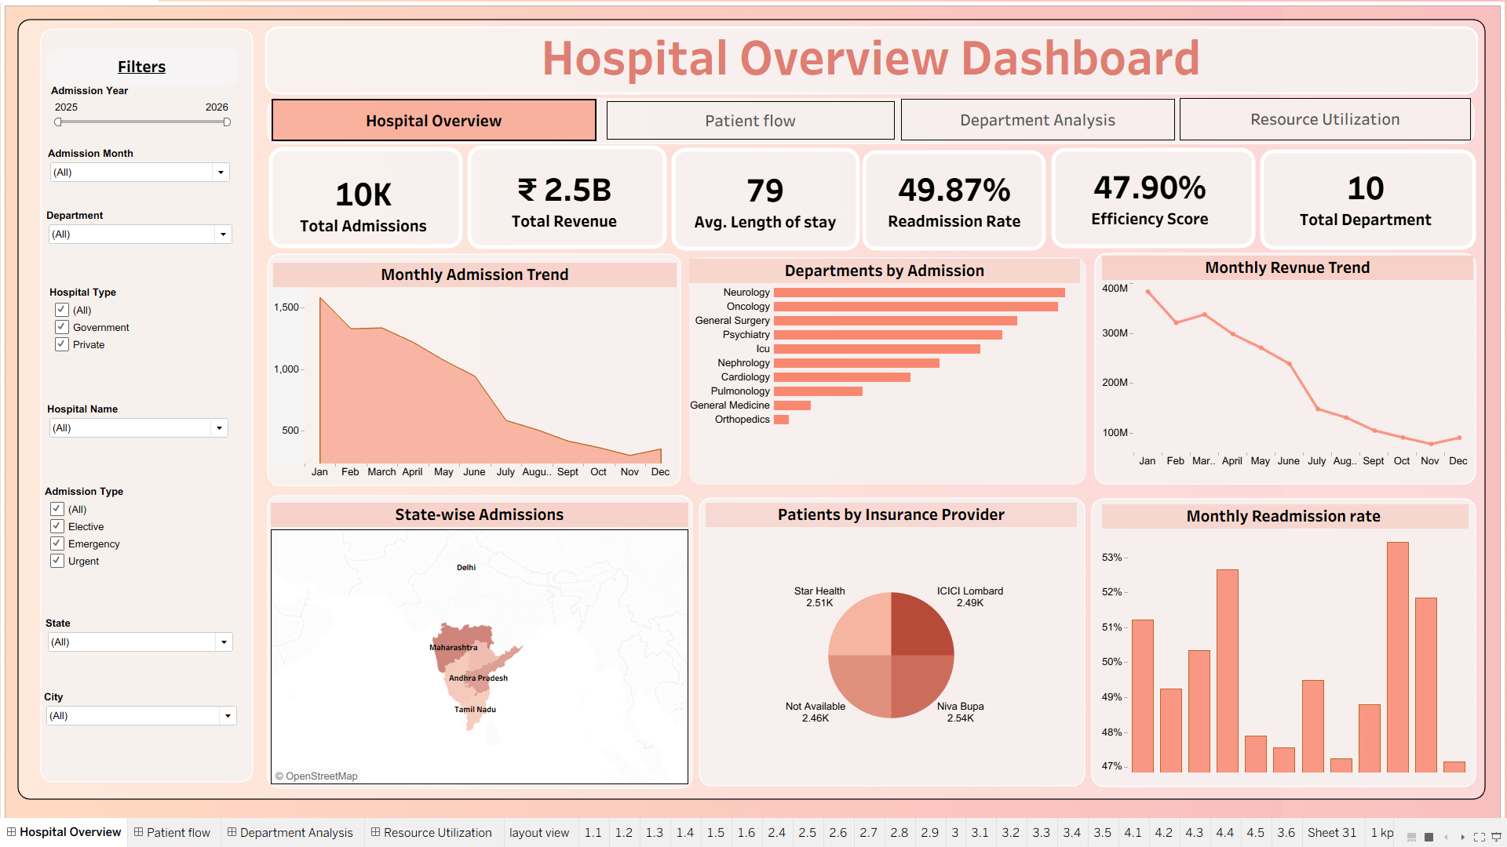
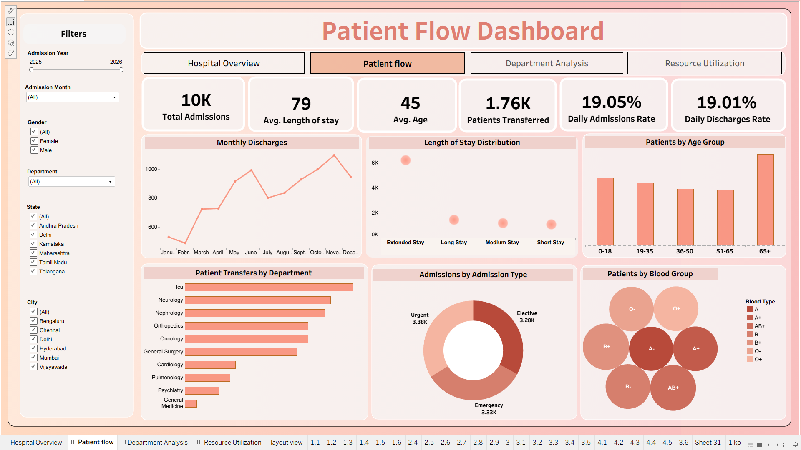
Dashboard Development
Hospital Overview
Patient Flow
High-level view of activity and performance — admissions, revenue, length of stay, readmissions, efficiency and monthly trends. The entry point for every other dashboard.
Who the patients are and how they move — admissions, discharges, transfers, admission types, age groups and length-of-stay categories.
11
All four dashboards share one cleaned dataset, consistent filters and cross-dashboard navigation.
Notes:
Four dashboards, each answering a different operational question, built on the same cleaned dataset.

Slide 12
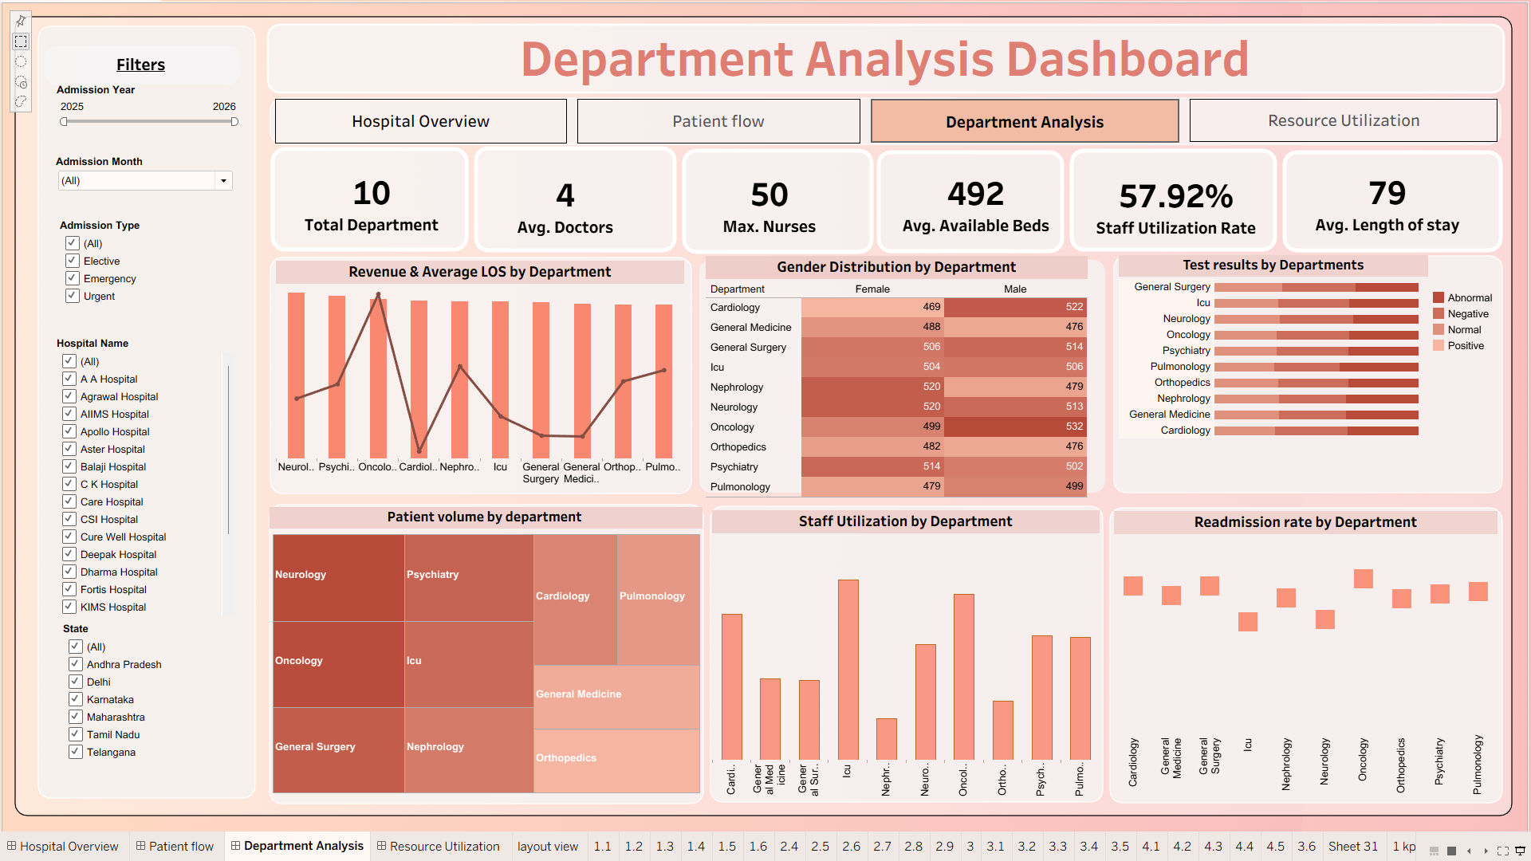
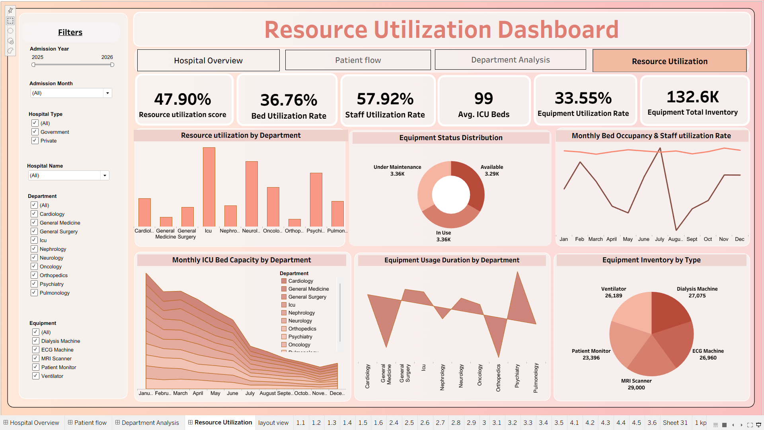
Department Analysis
Resource Utilization
Workload and performance compared across ten departments using volume, revenue, LOS, staff utilisation, bed occupancy and readmission.
Whether beds, staff, ICU capacity and equipment are available and used effectively, combined with capacity and equipment status.
12
All four dashboards share one cleaned dataset, consistent filters and cross-dashboard navigation.
Notes:
Screenshots are from the Power BI build; the same four dashboards exist in the Tableau workbook with identical KPI values.

Slide 13
Key Results & Insights
Severe Equipment Backlog: Exactly 50% of all medical equipment (3,360 units) is currently down for maintenance, matching the exact number of units in use.
Critical Readmission Rate: Nearly 50% of patients are readmitted, strongly linked to our 65+ demographic and their extended average length of stay (79 days).
The "Staff vs. Space" Paradox: The hospital has excess physical capacity (only 36.7% Bed Utilization) but faces severe workforce strain (57.9% overall Staff Utilization).
ICU & Neurology Overload: These two departments absorb the vast majority of internal patient transfers, leading to massive spikes in localized staff burnout.
Strategic Recommendations
Asset Management: Launch an immediate audit of the equipment repair pipeline to bring offline assets back into use.
Staff Rebalancing: Reallocate workforce resources to relieve the highly stressed ICU and Psychiatry departments.
Post-Discharge Care: Improve post-discharge protocols specifically for the vulnerable 65+ age group to lower the 50% readmission rate.
13
Notes:
Staff utilisation is the highest of the three utilisation measures; bed and equipment utilisation both sit in the thirties.

Slide 14
Testing, Challenges & Learning
Skills learned
Testing & QA
Challenges faced
Data Storytelling over Simple Reporting: Learned to look beyond the numbers to find the business problem
Advanced Dashboard Design: Improved technical skills in UI layout, dual-axis charts, and directing the user's eye to urgent warning metrics.
97.5%
Complex KPI Logic: Validated the math behind the 49.87% readmission rate to ensure repeat patients were tracked correctly, not just counted as new.
Data Duplication Risks: Monitored total row counts during dataset joins to ensure top-level metrics Performance Optimization: Optimized data extraction and interactive elements to ensure the dashboards loaded smoothly during a live presentation.
PASS RATE
40 test cases executed, 39 passed
Zero major issues recorded
Filters, navigation and cross-filtering tested
Tableau values compared with Pandas
One open item: Total Inventory KPI definition
Tableau Dashboard design & QA
Consistent filters, navigation and structured test cases before delivery.
14
Notes:
Forty test cases were run across KPI values, filters, navigation and interactions. The one open item is the Total Inventory KPI on the Resource Utilization dashboard.

Slide 15
Conclusion & Future Scope
Conclusion
Future scope
The project delivers a complete analytics workflow — data collection and cleaning, KPI engineering, dashboard development, testing and documentation. The four dashboards give complementary views of hospital performance and support evidence-based operational analysis, and the work shows why independent KPI validation, clear metric definitions and consistent filtering matter when presenting healthcare data.
Automated data refresh and scheduled updates
Hospital-level benchmarking and department comparison
Forecasting of admissions, bed demand and resources
Capacity-planning and staffing support analysis
Additional automated checks before publication
Thank You !
15
Notes:
Thank you. I am happy to take questions on the KPI definitions or the dashboard design.

